Slide 1

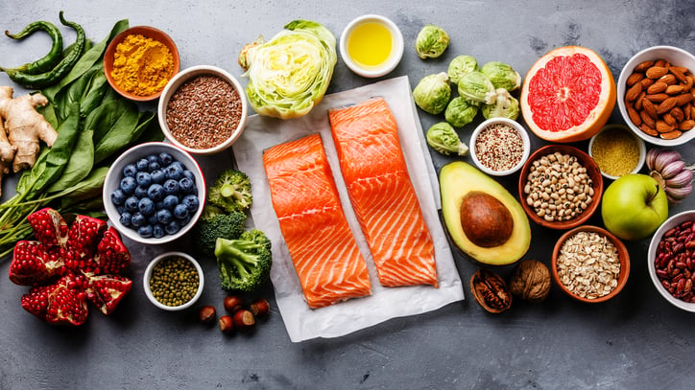
Food Image Classification
Akul Arun (S10243523)
(S10243523)
Notes:
I am Akul and today I will be presenting on food image classification.

Slide 2
Table of Contents
01
04
Problem Understanding
Scratch Model
02
05
Baseline Model
Pre-train Model
03
06
Data Preprocessing
Model Comparison
Notes:
These are the contents I will be sharing today.

Slide 3
Problem Understanding
Aim
Build Models to Recognise and Classify 10 types of Food
Problem Type
Multi Class Classification
Notes:
The objective of this project is to create an image classification model able to recognize and classify 10 food types

Slide 4
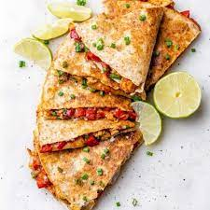
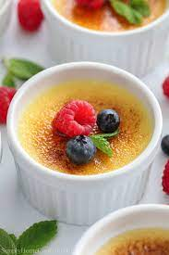
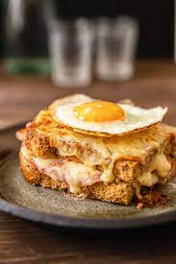
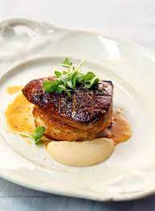

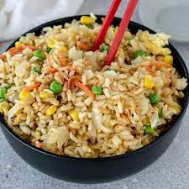

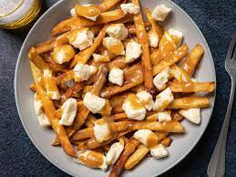
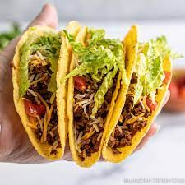
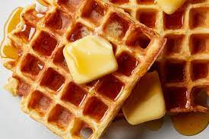
Food Classes
Chicken Quesadilla
Crème Brulee
Croque Madame
Foie Gras
Fish And Chips
Fried Rice
Paella
Poutine
Tacos
Waffles
Notes:
These are the food to classify.

Slide 5
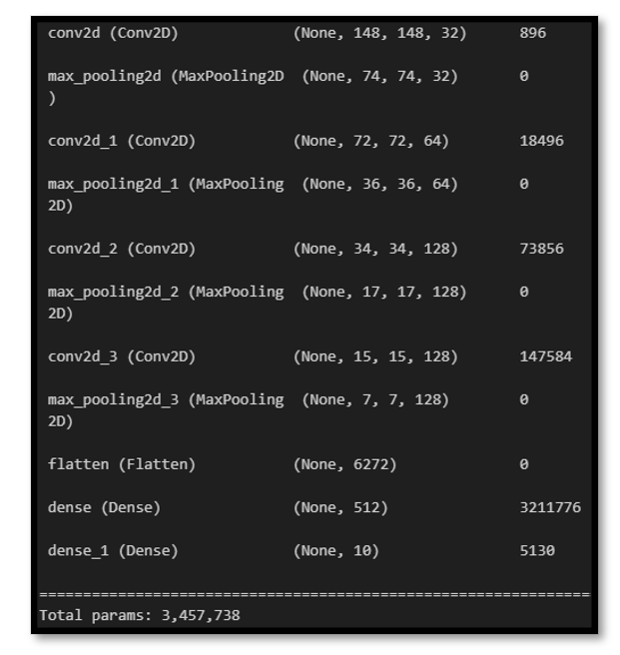
Baseline Model
Test
Test Data Preprocessing
Reference
Evaluate Performance of More Complex Models
Baseline Architecture
Notes:
A baseline model is a simple, minimal-effort model used as a reference point for evaluating the performance of more complex models. My baseline model had 11 layers and 3 million parameters which was moderate complexity and a good starting point.

Slide 6
Data Preprocessing
Data Augmentation
Data Splitting
Image Size
Notes:
Moving to data pre processing.

Slide 7

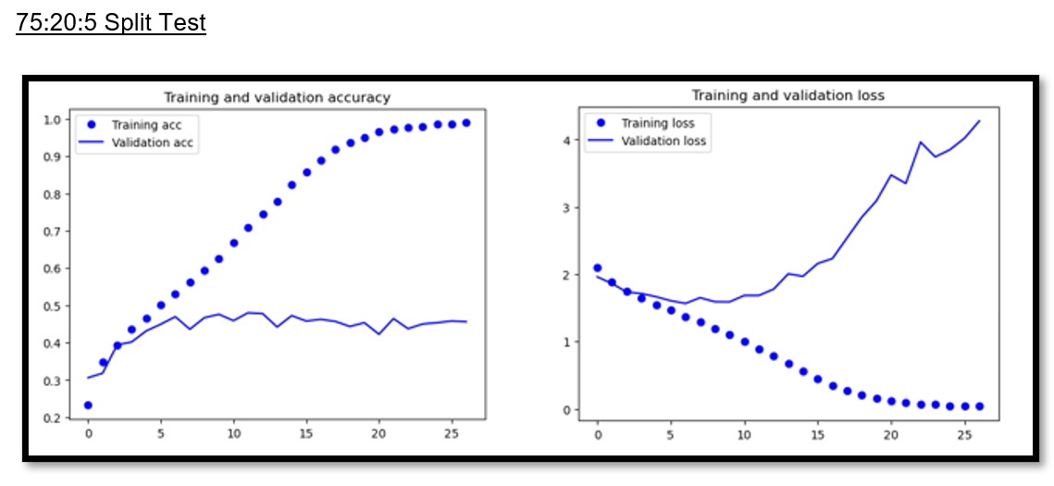

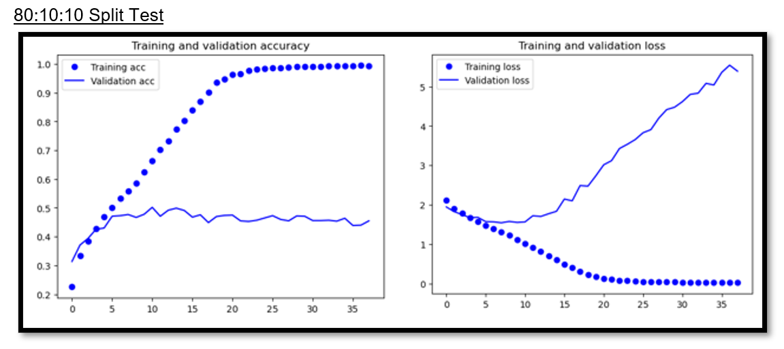
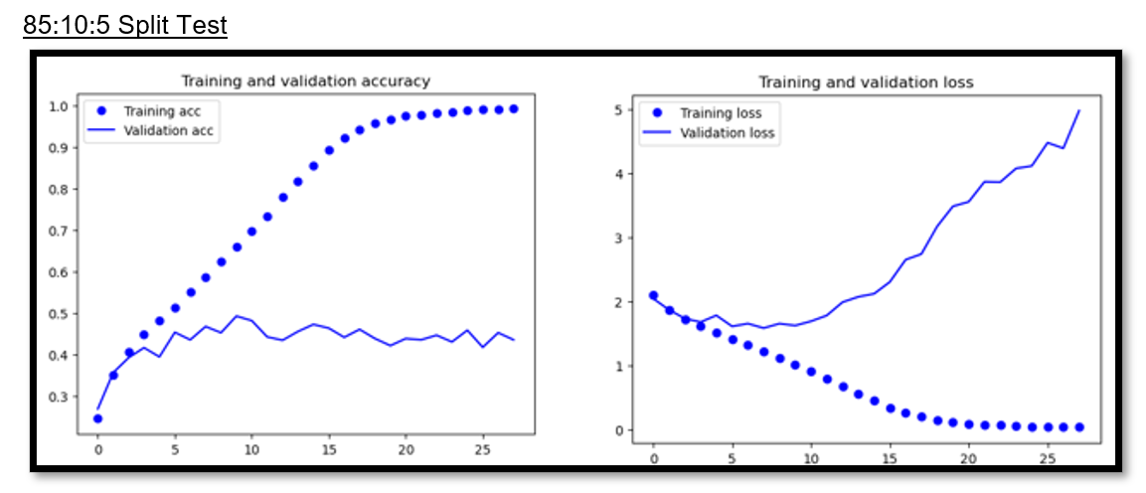
Data Split Test
Default Split:75:20:5
Test 1: 80:10:10
Test 2: 85:10:5
Notes:
I felt like this was a relatively small dataset and I found that it was common practice to assign more images to the train set in cases of a small dataset so I tested out more data splits where I increased the number of images in the train set. The two other splits I tested were the popular 80:10:10 split and the 85:10:5 split. However, the model performance did not have any significant changes and the validation accuracy of the model remained around the same value. However, the model tends to be more noisy as the value for the train split is increased and the rate of overfitting is also faster as demonstrated by the steeper gradient of the curve of the 80:10:10 and 85:10:5 split tests. I decided to stick with the 75:20:5 split as data augmentation can be done later.

Slide 8
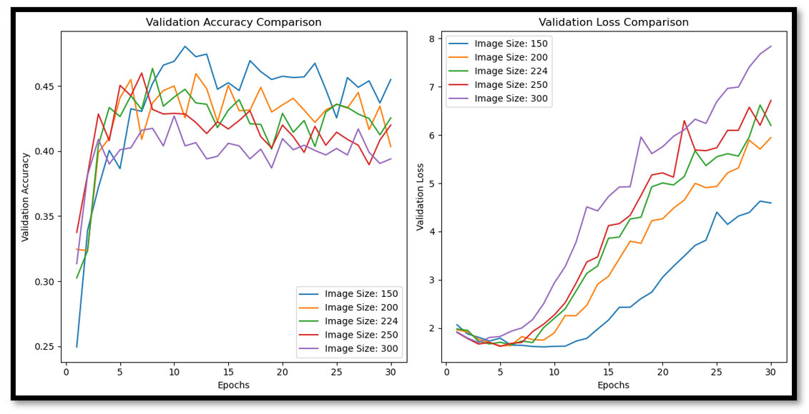
Image Size Test
Higher Image Size Performed Worse
Higher image size had faster overfitting & Lower validation accuracy
Model was not complex enough for bigger images
Decided to settle on image size 224; 224x224 images are large enough to capture meaningful details, but are not overly large
strike a balance between computational efficiency and information content.
Notes:
Bigger image sizes did not perform better as seen by the lower accuracies and higher rate of overfitting. However, this could also mean that the model was not complex enough to detect relevant features in the bigger-sized images which is why the smaller-sized images performed better. However, I decided to use image size 224 which is commonly used by experts as it is large enough to capture meaningful details, but are not overly large, helping to strike a balance between computational efficiency and information content.

Slide 9
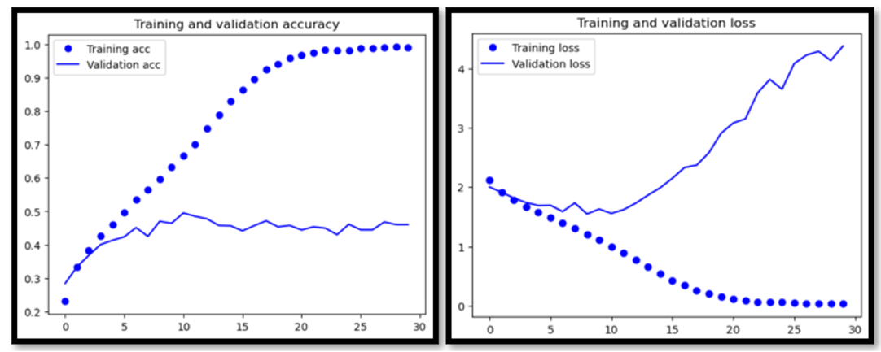
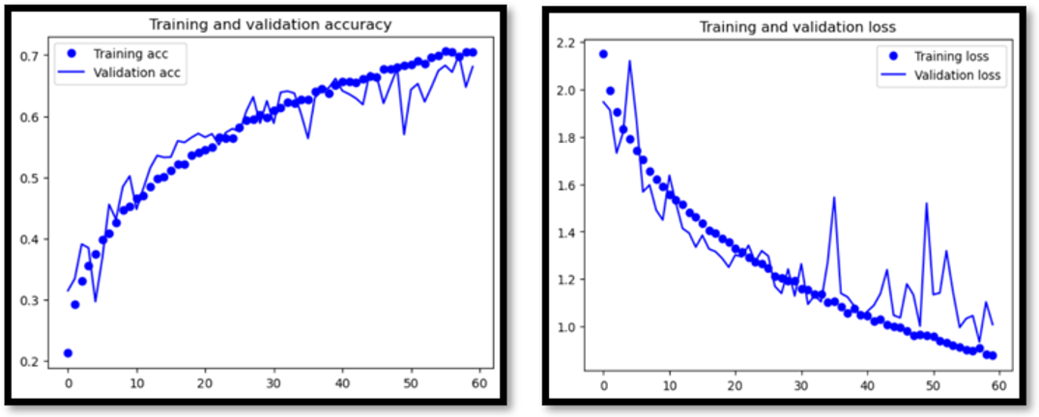
Data Augmentation
Before Augmentation
After Augmentation
Overfit faster
Higher val loss of 1.6
Lower val accuracy of 0.43 at epoch 30
Overfit slower
Lower val loss of 1.0
Higher val accuracy of 0.6 at epoch 30
Notes:
Data augmentation artificially creates new images and through augmentation, a greater diversity of images enhances the model's ability to recognize patterns that are invariant across various instances, increasing accuracy on unseen data. For data augmentation I applied changes to the position, angle, colour and brightness of the images. After augmentation, the model is not overfitting even after 60 epoch, the validation loss decreased to 1.0 from 1.6 and accuracy increased from 0.43 to 0.6 at epoch 30.

Slide 10

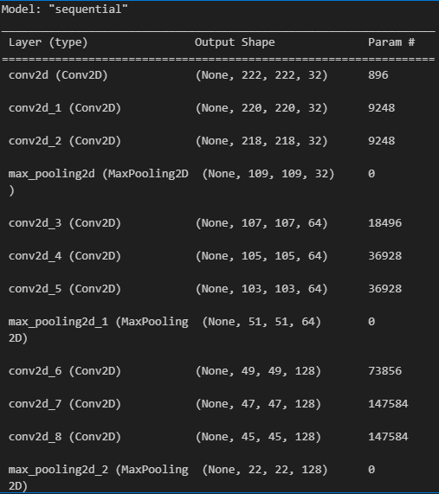
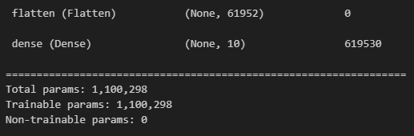
Model From Scratch
Best Model
Batch Size Test
01
Model Architecture Test
02
03
Optimizer + Learning Rate Test
04
Learning Rate Scheduler Test
05
Regularisation Test
Notes:
Now, I will share about arriving at my best scratch model.

Slide 11
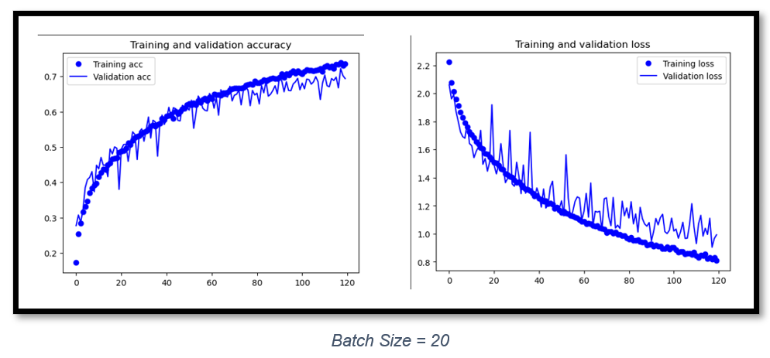
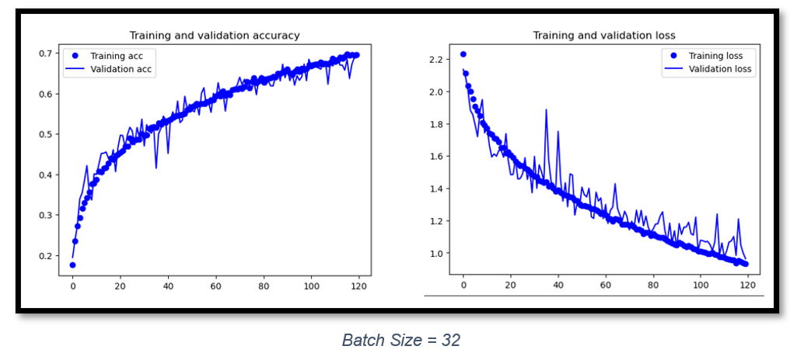
Batch Size Test
Batch Size 20:
More noisy
Showing early signs of overfitting
Similar performance at epoch 120 at around 70% val acc, 1.0 val loss
Batch Size 32:
Less noisy
Smaller gap between validation loss and training loss
Similar performance at epoch 120 at around 70% val acc, 1.0 val loss
Notes:
Higher batch size can improve model convergence and improve training stability. My model became less noisy and started to overfit slower as the gap between validation loss and training loss is closer. The validation loss was similar for both models at 1.0 at epoch 120 and accuracy was around 70% for both. The tick shows the configuration that I decided to continue with for future tests and best model building so I continued with batch size 32 for future tests.

Slide 12
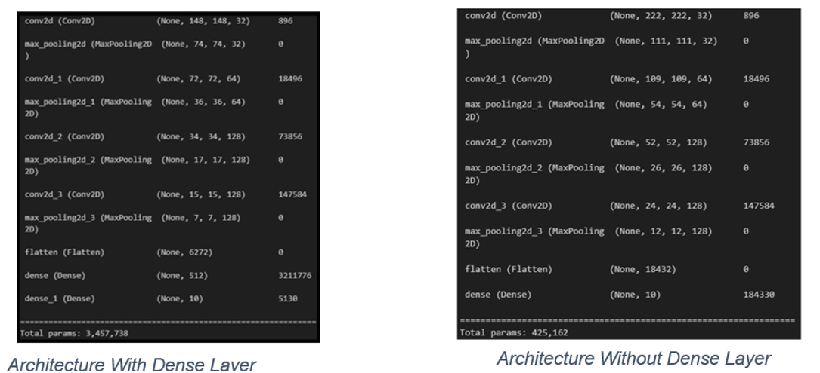
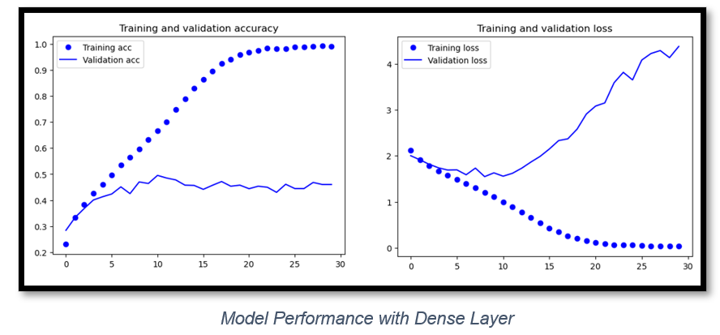
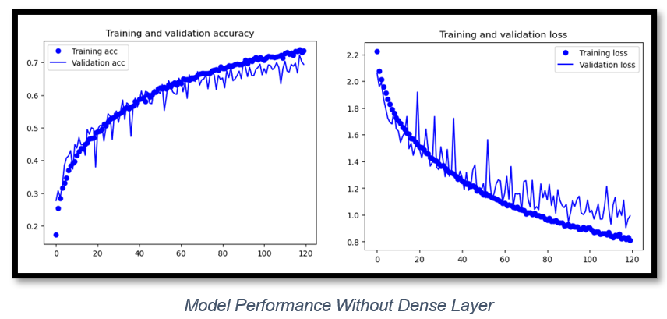
Decrease Model Complexity: Remove Second Last Dense Layer
With Dense Layer:
No. of Params: 3 million
Overfit faster; higher val loss
Lower val acc
Without Dense Layer:
No. of Params:
400,000
Slower overfitting; lower val loss
Higher val acc
Notes:
The number of params significantly dropped from 3 million to 400,000 after I removed the second last dense layer due to the elimination of connections and associated weight parameters. With the dense layer, my model was performing more poorly and overfitting at the 10th epoch but after removing it, the validation accuracy increased from 44% to 70% and was underfitting at the 120 epoch. The dataset is small so a simpler model would be more effective with lower risk of overfitting and continued model building without the dense layer.

Slide 13
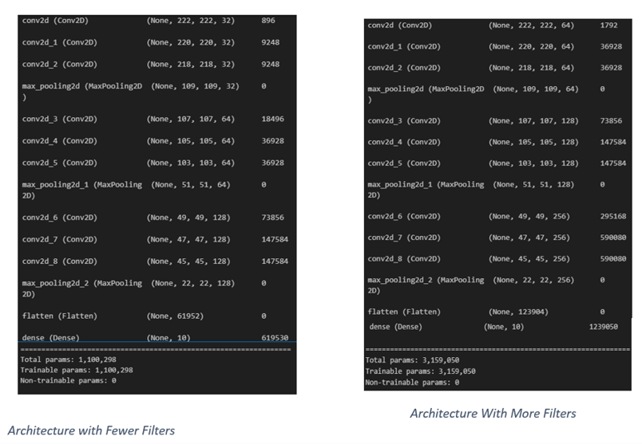
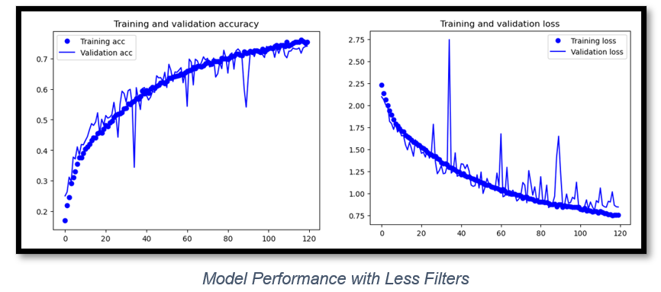
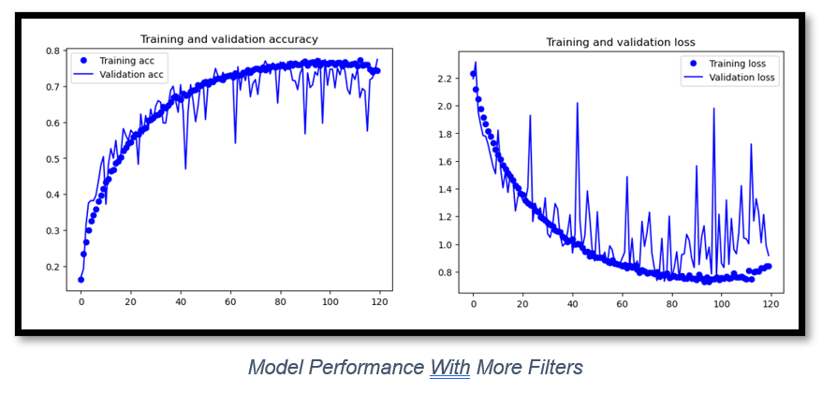
Increase Model Complexity: Increase Filter Size
Less Filters:
No. of Params: 1.1 million
Less Noisy
Still underfitting at epoch 120
More Filters:
No. of Params: 3.5 million
More Noisy
Overfitted at epoch 100
Notes:
Increasing the filter size made the model too noisy and started to overfit faster at around epoch 100 due to the increased complexity as more filters could capture more complex patterns and noise in the training data which can be undesirable as the model will fail to generalise to new data so I stayed with few filters.

Slide 14
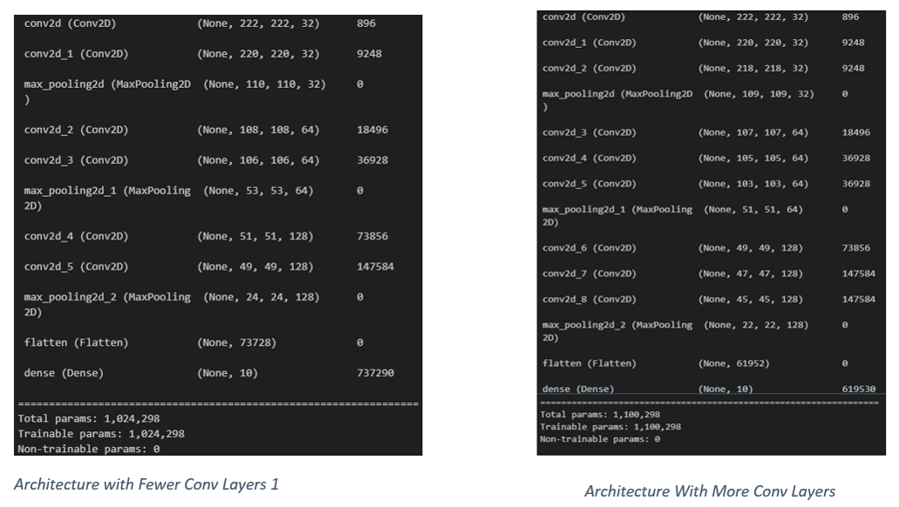
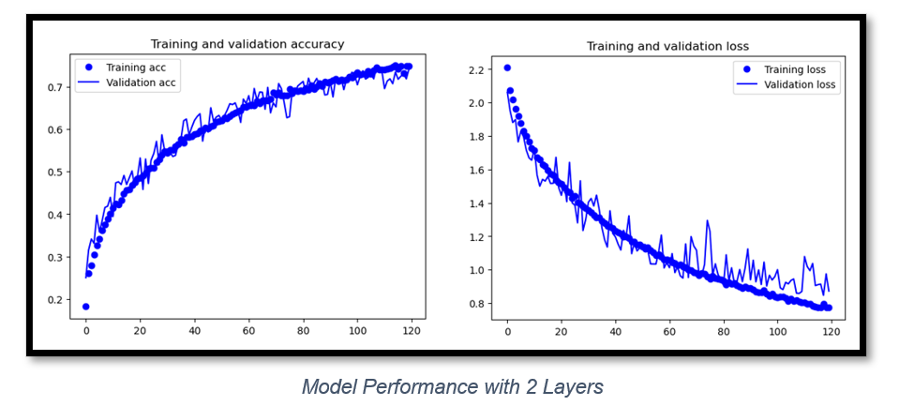
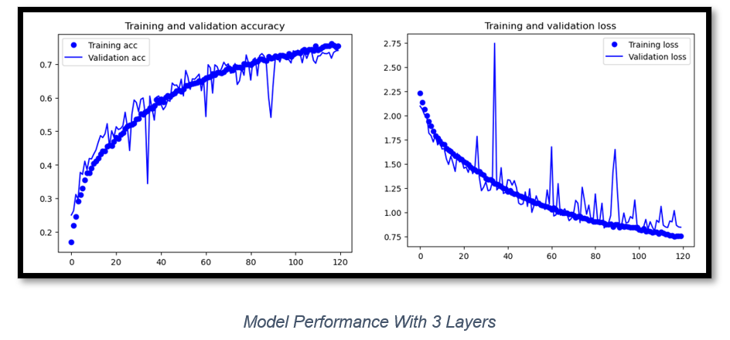
Increase Model Complexity: Increase Conv Layers
2 Conv Layers:
No. of Params: 1 million
validation loss of 0.95 at epoch 120
3 Conv Layers:
No. of Params: 1.1 million
a validation loss of around 0.85 at epoch 120
Notes:
The addition of more convolutional layers has minimal change to the model complexity and params as convolutional layers typically share weights across regions of the input. Before, my model achieved a validation loss of 0.95 at epoch 120 but after more convolutional layers, my model achieved a validation loss of around 0.85 at epoch 120. Hence, I decided to continue with 3 convolutional layers.

Slide 15
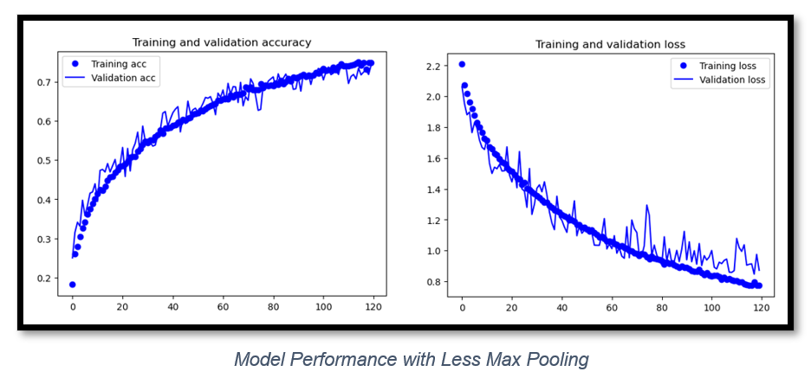
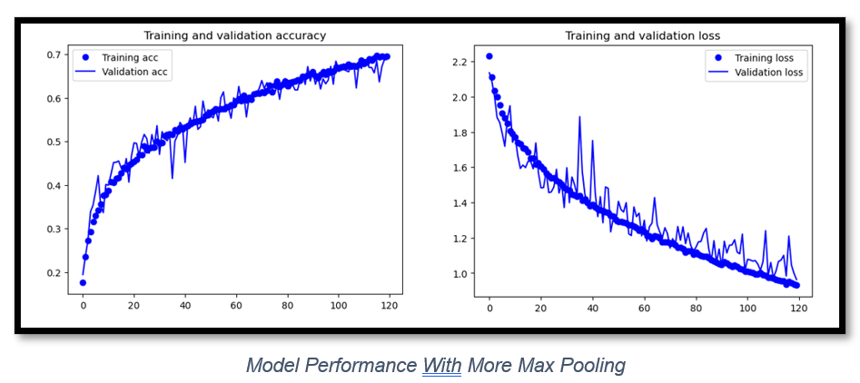
Max Pooling Layers Test
3 Max Pooling Layers:
Break past 70% accuracy
validation loss decreased from around 1.0 to around 0.9 at epoch 119
More spatial details; improve generalisation
4 Max Pooling Layers:
Less than 70% accuracy
Validation loss of 1.0 at epoch 120
Notes:
Removing a max pooling layer improved the performance of my model and it managed to break past 70% accuracy and its validation loss decreased from around 1.0 to around 0.9. Reducing max pooling layers preserves more spatial details which improves model generalization so I continued with 3 max pooling layers.

Slide 16
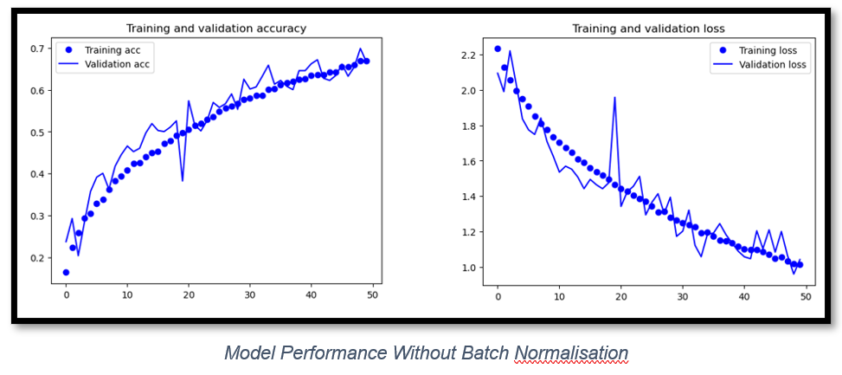
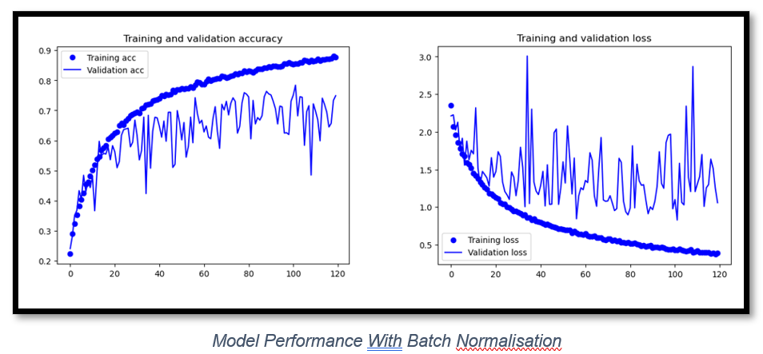
Batch Normalisation Test
Without Batch Normalisation:
Less noisy
Validation loss shows signs of further decreasing below 1.0
WithBatch Normalisation:
More noisy
Validation loss stayed around 1.0
Notes:
I decided to implement batch normalization for faster training as it is a technique that normalizes the inputs of a neural network layer to have zero mean and unit variance and quickens the convergence of the model. However, batch normalization had negative effects as it introduced too much noise and stagnated at a validation loss of around 1.0. Without batch normalization, the model still shows signs of further decrease from validation loss 1.0. Model with too much noise will fail to generalize to new data so I decided to continue without batch normalization.

Slide 17
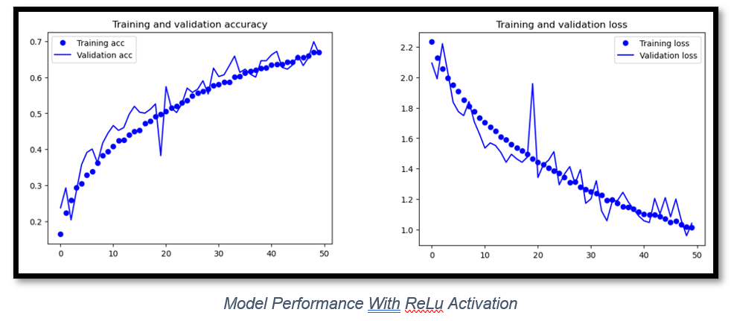
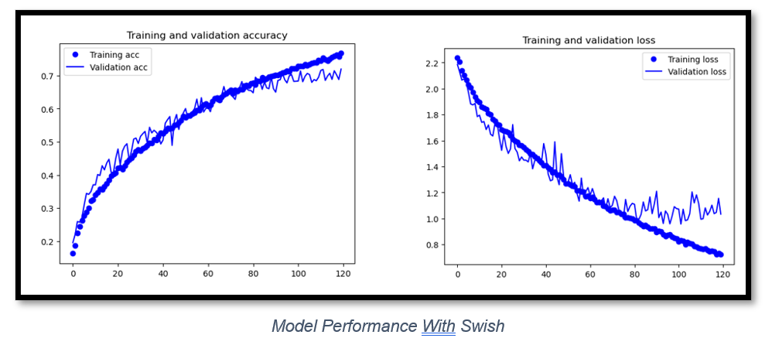
Activation Function Test
ReLu Activation Function:
Achived validation loss of 1.0 in 50 epoch
Showed no sign of overfitting
Swish Activation Function:
Non-monotonic; Less Noise
Started overfitting around validation loss of 1.0 after epoch 80
Notes:
I decided to test some activation functions and find out their effect on my model. I decided to implement swish to reduce noise as is a smooth, non-monotonic function that tends to reduce the vanishing gradient problem. The swish activation decreased the model performance as the model with ReLu achieved a validation loss of 1.0 in 50 epoch and was still underfitting and the model with swish started overfitting after epoch 80 after achieving validation loss of 1.0. Its non-monotonic nature might have affected model convergence and performance so I continued with ReLu.

Slide 18
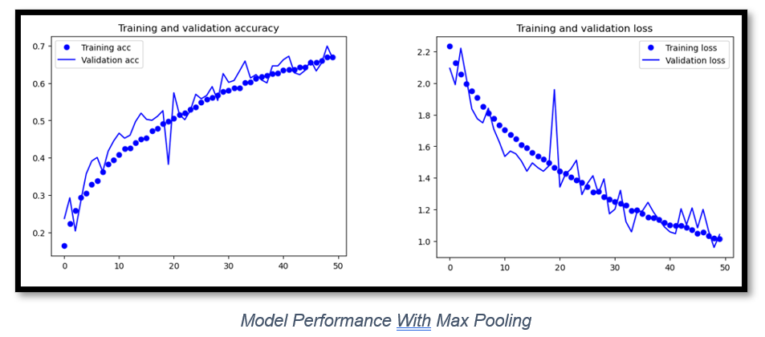
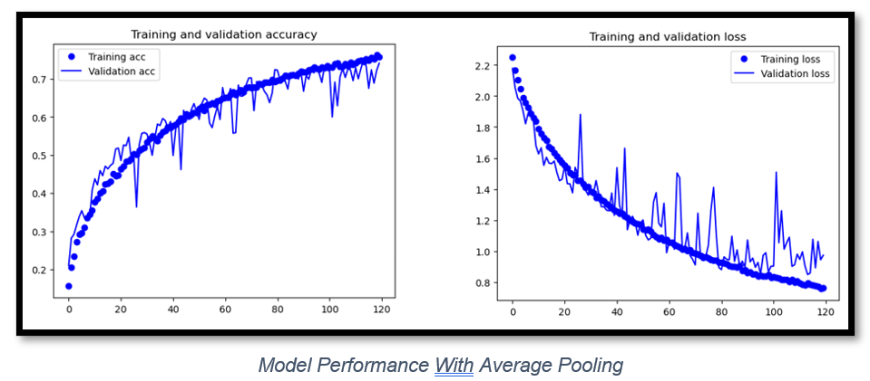
Pooling Type Test
Max Pooling:
At the 50th epoch, the validation loss of the model with max pooling was 1.0
Retains more prominent features by selecting the maximum value within each pooling region
Allows the model to capture more distinctive patterns and improve performance
Average Pooling:
Average pooling region in the input is replaced by the average value of that region, reducing the spatial dimensions of the data
At the 50th epoch, the validation loss of the model with average pooling was 1.1
Notes:
The model performed better with max pooling because at the 50th epoch, the validation loss of the model with max pooling was 1.0 but that of the model with average pooling was still around 1.1. Max pooling retains more prominent features by selecting the maximum value within each pooling region, allowing the model to capture more distinctive patterns and improve performance. Hence, I continued with max pooling.

Slide 19
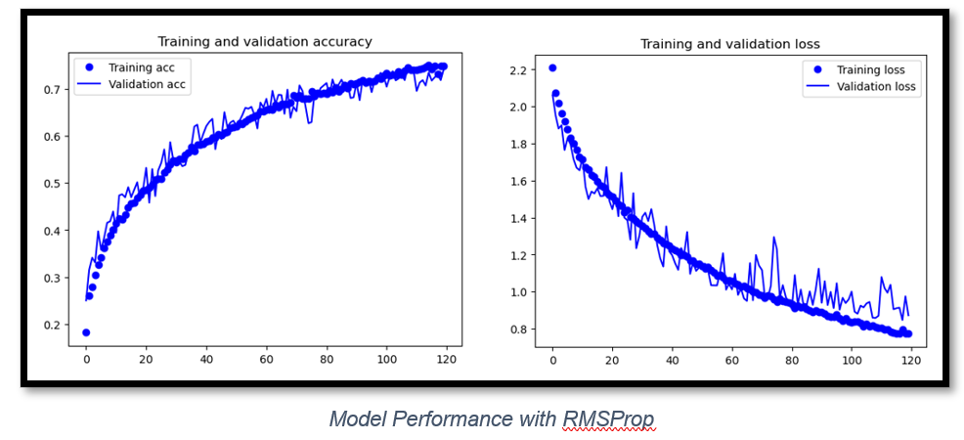
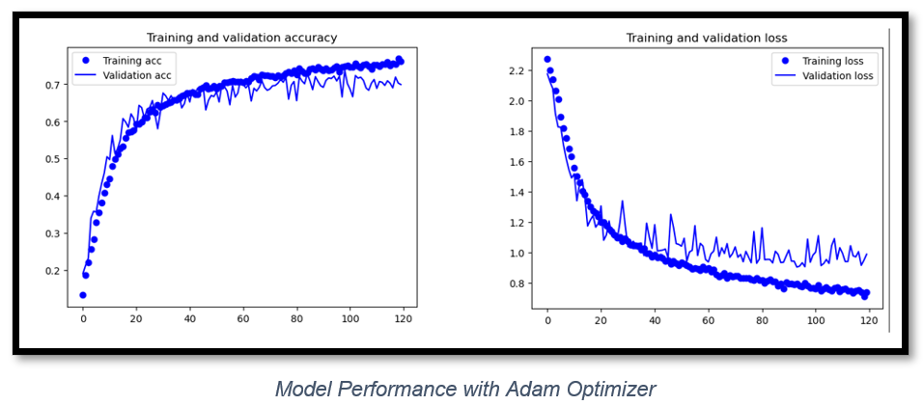
Optimizer Test
RMSProp:
RMSProp did not overfit and managed to achieve a validation loss of around 0.9 in 120 epoch
Adam:
combines the benefits of momentum and RMSprop, adapting the learning rates for each parameter individually
Performed More Poorly
Started overfitting at epoch 45 and its validation loss stayed around 1.0.
Notes:
The Adam optimizer made my model perform more poorly than the RMSProp optimizer. With Adam, the model started overfitting at epoch 45 and its validation loss stayed around 1.0 but the model with RMSProp did not overfit and managed to achieve a validation loss of around 0.9 at epoch 120.

Slide 20

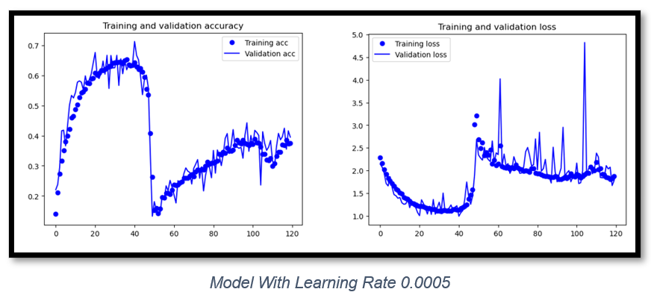
Learning Rate Test
Learning rate = 0.0001:
Suitable learning rate
Did not face any problems
Learning Rate = 0.0005:
Faces Divergence
model overshoots the optimal solution
Notes:
The learning rate can affect the speed at which the model trains which is why I increased the learning rate from 0.0001 to 0.0005. However, the model faced a sudden drop in accuracy and a sharp increase in loss which indicates divergence due to the learning rate being too high and the parameters changing too quickly, causing the model to overshoot the optimal solution. Hence, I continued with 0.0001 learning rate.

Slide 21
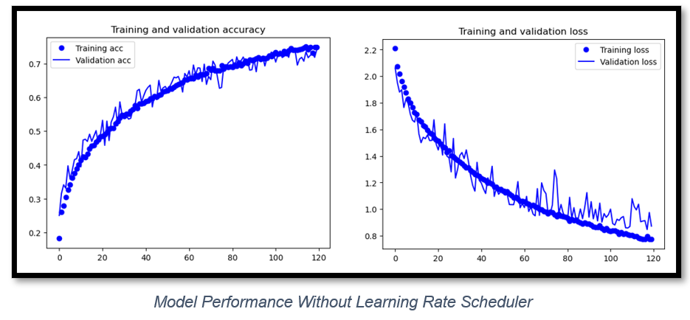
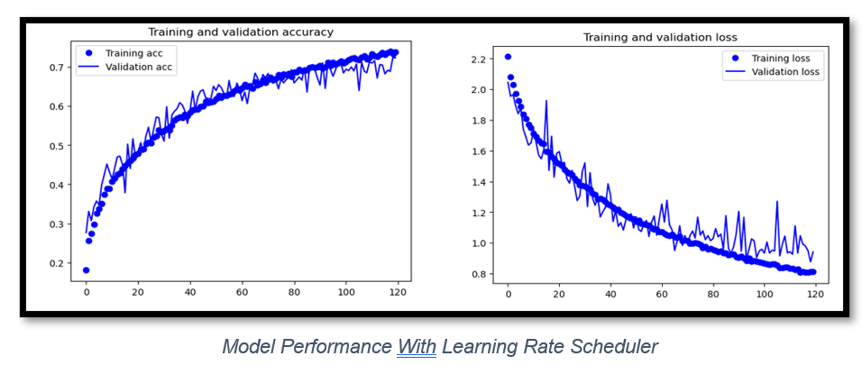
Learning Rate Scheduler Test
Without Learning Rate Scheduler:
Higher validation accuracy
Less overfitting; validation loss graph and training loss graph of model with scheduler is closer together
With Learning Rate Scheduler:
Lower validation accuracy
More overfitting; validation loss graph and training loss graph of model with scheduler is further away
Notes:
I decided to use learning rate scheduler with exponential decay to dynamically adjust the learning rate which can improve model convergence. However, the learning rate scheduler did not improve my model performance and my model had a higher validation accuracy over 70% without learning rate scheduler but barely managed to hit 70% percent accuracy with the scheduler in the same number of epochs. The validation loss graph and training loss graph of model with scheduler is further away which shows more overfitting.

Slide 22
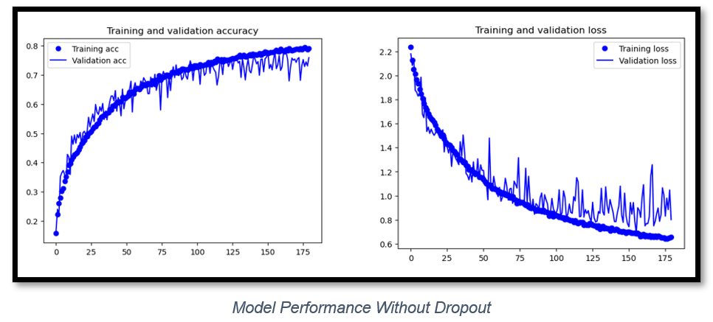
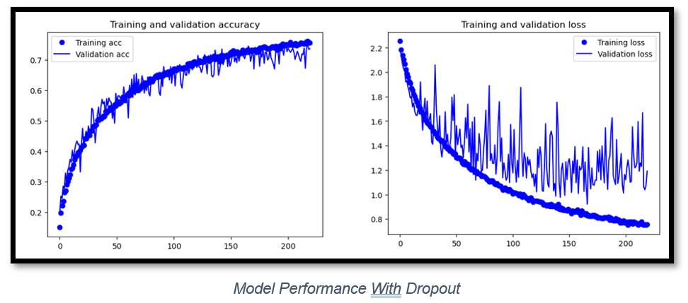
Dropout Test
Without Dropout:
Higher validation accuracy of around 0.75
Validation loss decreased to around 0.8 at epoch 150
Slower overfitting
With Dropout:
Lower validation accuracy or around 0.71
validation loss of the model with dropout stayed at 1.0 after epoch 120
More noise; different active neurons in each epoch can lead to more noise.
Faster overfitting and reduced accuracy; loss of information made it harder for the model to learn generalizable features
Notes:
The addition of dropout made my model perform worse as it had a lower validation accuracy of around 71% which was drop from around 75% and the validation loss of the model with dropout stayed at 1.0 after epoch 120 while the one without dropout managed to decrease to about 0.8 at the 150th epoch. Dropout is supposed to make my model overfit slower but in my case, it made the model overfit faster maybe due to the dataset being small and dropping neurons resulted in loss of information made it harder for the model to learn generalizable features. This is also why the accuracy is lower. I did not include dropout in my final model.

Slide 23
Pre-Trained Model
Model Fine Tuning
Feature Extraction with MobileNet & VGG16
Feature Extraction With Augmentation
Notes:
Now I will be sharing about building the pre-train model.

Slide 24
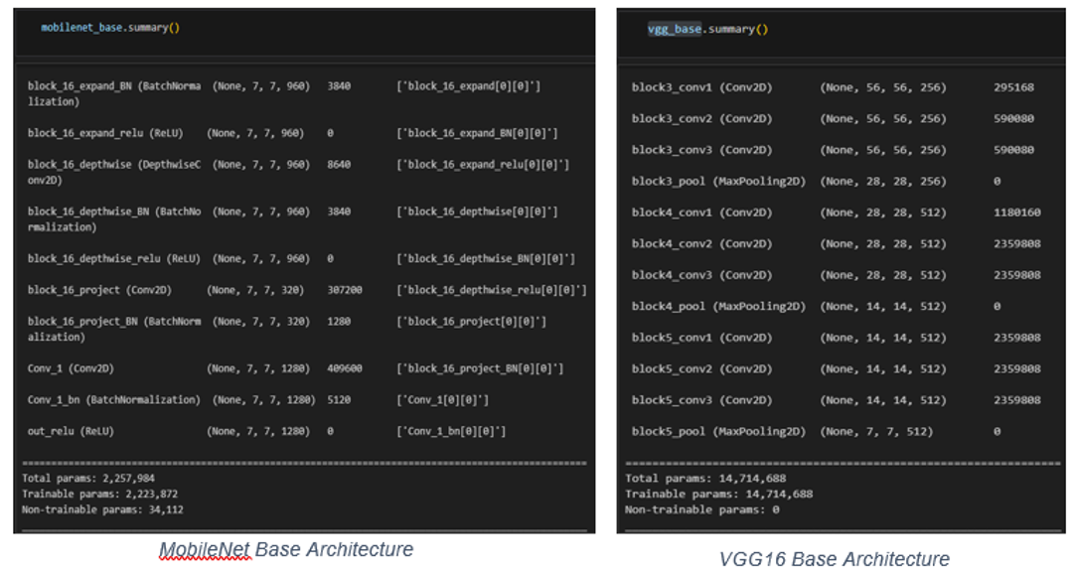
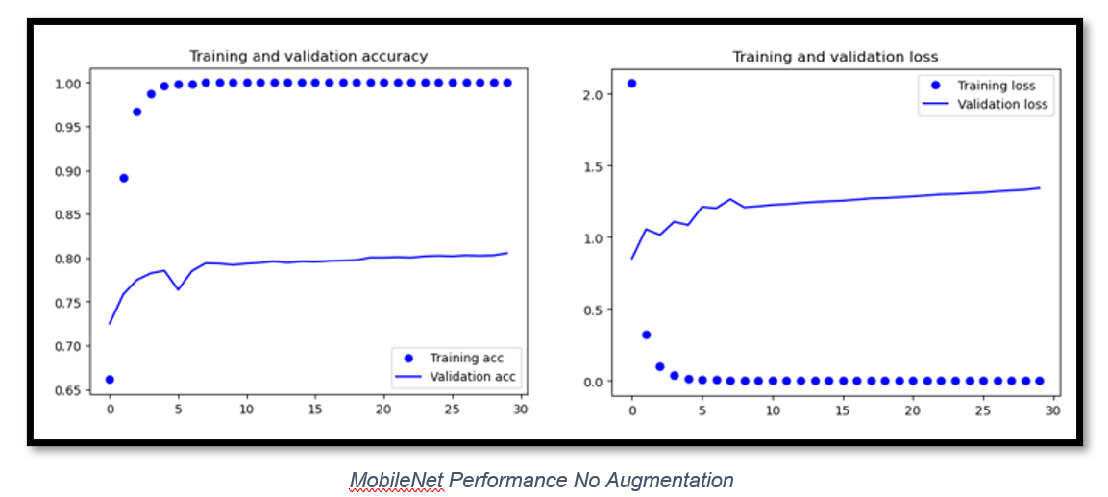
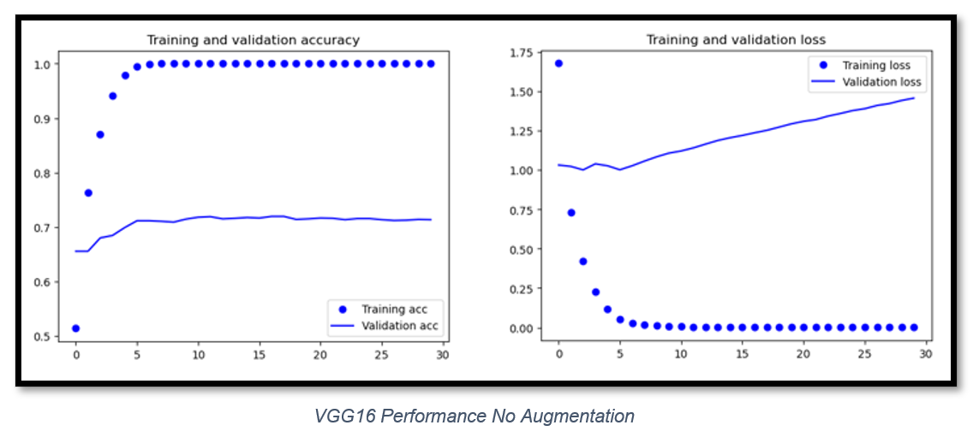
Feature Extraction: MobileNet vs VGG16
MobileNet:
No. of Params:
2.2 million
Slower Overfitting
Higher val accuracy > 80%
VGG16:
No. of Params:
14.7 million
Faster Overfitting
Lower val accuracy around 71%
Notes:
I tested 2 different pretrain models of different complexities so how they compared on my dataset. Like my scratch model, MobileNet, with less params of 2.2 million performed better than a more complex VGG16 with 14.7 million params. The MobileNet model performs better than the VGG16 model and exceeds 80% accuracy while the VGG16 model only manages to hit around 71% accuracy. The VGG16 model also started to overfit faster at the 5th epoch while the MobileNet started overfitting at a slower rate around the 8th epoch as seen from the gradient of the validation loss. Hence, for subsequent tests, I continued using MobileNet.

Slide 25
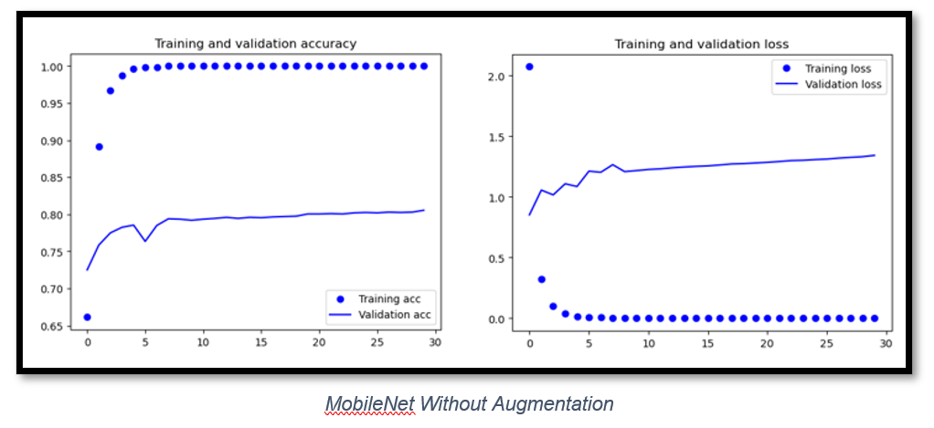
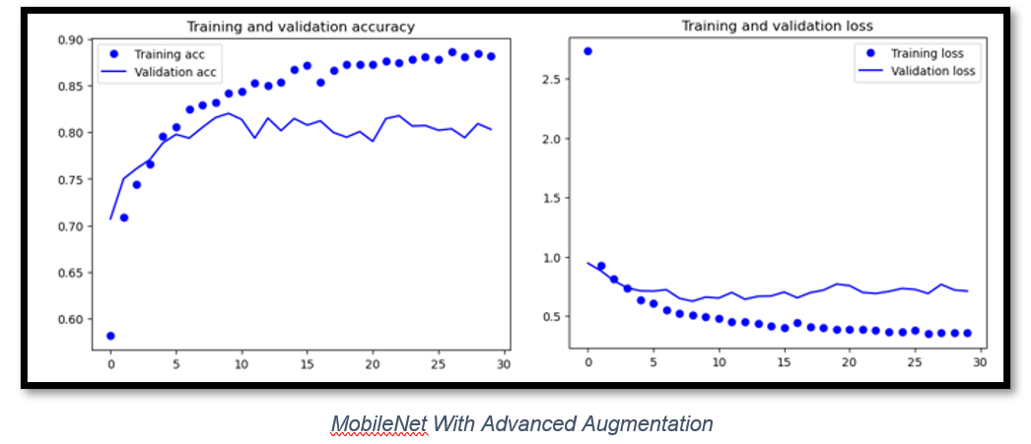
MobileNet Feature Extraction With Augmentation
Before Augmentation
After Augmentation
Validation loss did not increase at all
Validation accuracy stayed constant at around 80%
Validation loss decreased to 0.7 around epoch 6 before model overfit
Validation accuracy managed to increase past 80% by epoch 8
Notes:
The basic augmentation was helpful as after the basic augmentation, the model started to overfit after reaching a lower validation loss of 0.7 at around the 6th epoch and achieved a higher validation accuracy of around 82% by epoch 8. Before augmentation, the validation accuracy stayed around 80% and the validation loss did not decrease at all.

Slide 26
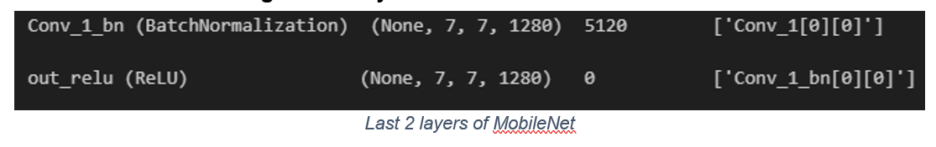




MobileNet Fine Tuning
Unfreezing Last 2 Layers
Unfreezing Last 3 Layers
Notes:
Model fine-tuning is done to help the model adapt to the new task and dataset, and this is done by unfreezing the last few layers. I only unfroze the last few layers as they are the ones capturing more task specific features. I did not unfreeze the last layer as the last layer had 0 params so there was no point unfreezing it. Unfreezing the last 3 layers made my model perform better. When the last 2 layers were unfreezed, the validation accuracy was around 79% at epoch 30. When the last 3 layers were unfreezed, the validation accuracy was around 82%. From the 5th epoch, the validation accuracy was constantly above 80%. This is because as more layers are unfreezed, the model captures more task-specific features.

Slide 27



Model Evaluation: Best Scratch vs Fine Tuned Pre-Trained
Best Scratch Model
Accuracy of 79% on Test data
Lower f1-scores across the classes; less effective in considering false positives and false negatives.
Fine-Tuned Pre-Trained
Accuracy of 83% on Test Data
Higher f1-scores across the classes; more effective in considering false positives and false negatives.
Notes:
The fine-tuned MobileNet model has a higher accuracy which indicates a higher number of correctly classified data instances over the total number of data instances. In this case, 83% of the 500 images were correctly classified, 4% greater than my best scratch model.
The MobileNet model has higher f1-scores across the classes, indicating that the model is more effectively considering false positives and false negatives.

Slide 28


Model Evaluation: Best Scratch vs Fine Tuned Pre-Trained
Best Scratch Confusion Matrix
Fine-Tuned Pretrained Confusion Matrix
Less correct predictions across the classes
More correct predictions across the classes
Notes:
The confusion matrixes also show the pretrained model has a greater number of correct predictions. Hence, we can conclude that the MobileNet model is the best model that I have created.

Slide 29
Thank You
Notes:
Thank you for listening.

